Slide 1
1.6 million UK traffic accidents
Ekin Öcal

Slide 2
What was my purpose?
Trying to compare the given data in the most useful way
Trying to evaluate all the data
Learning to use Django and transferring data properly

Slide 3
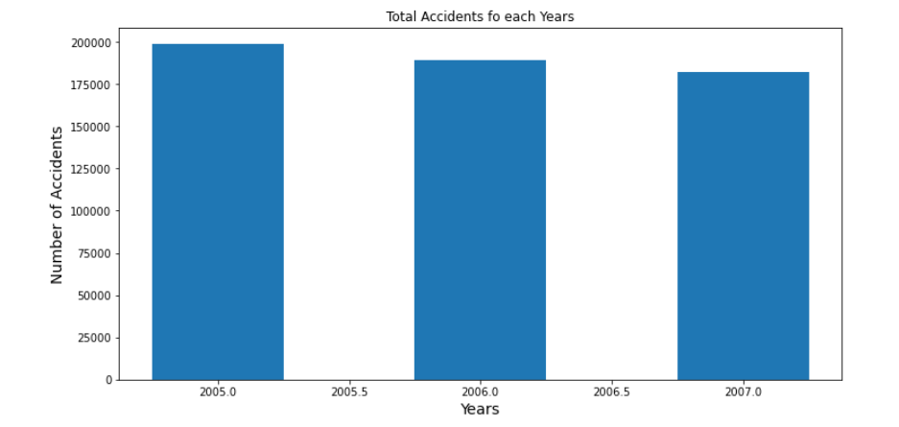
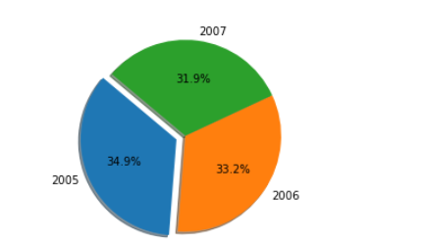
Total Accidents of 2005 to 2007

Slide 4
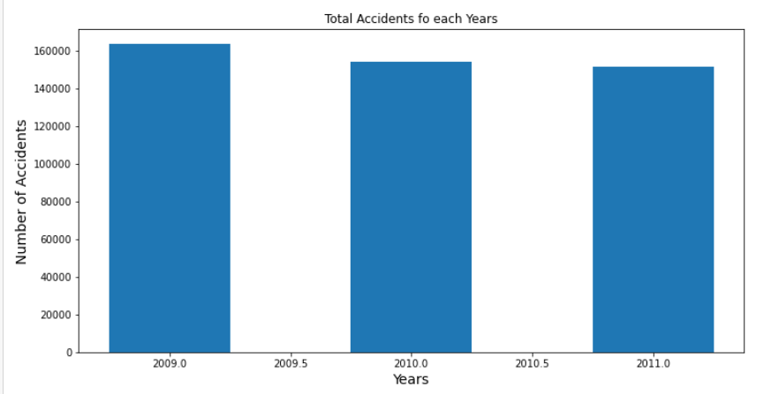
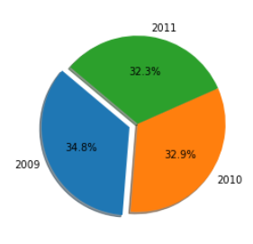
Total Accidents of 2009 to 2011

Slide 5
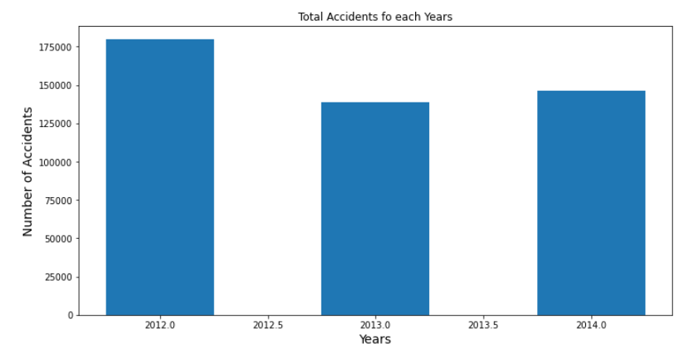
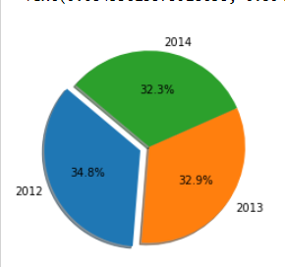
Total Accidents of 2012 to 2014

Slide 6
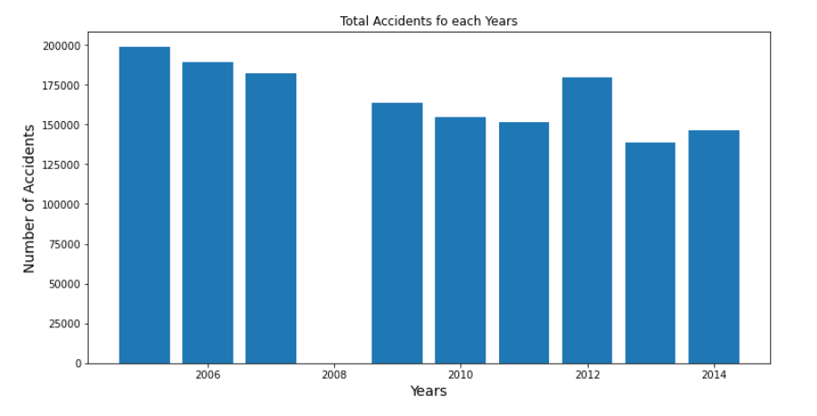
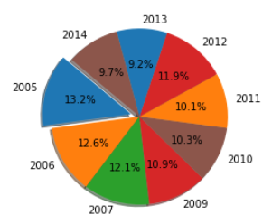
Total Accidents

Slide 7
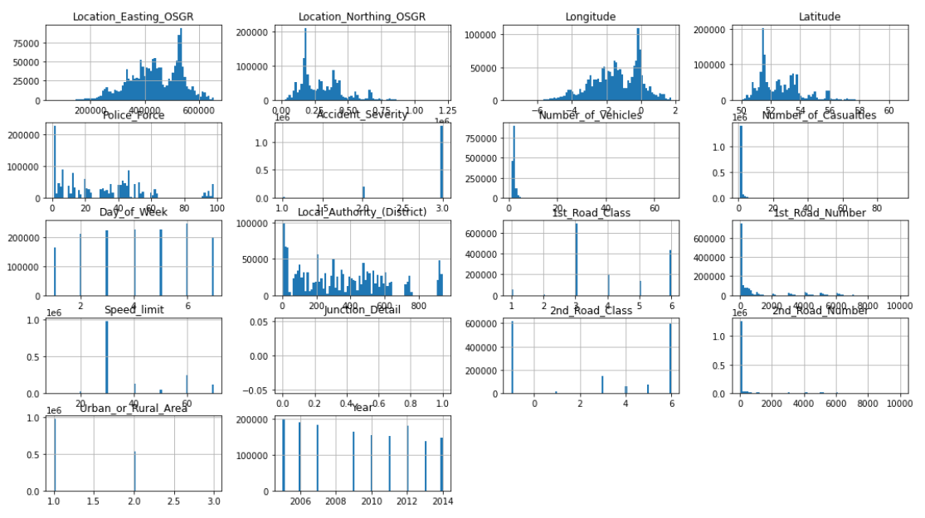
Histograms of all Datas

Slide 8
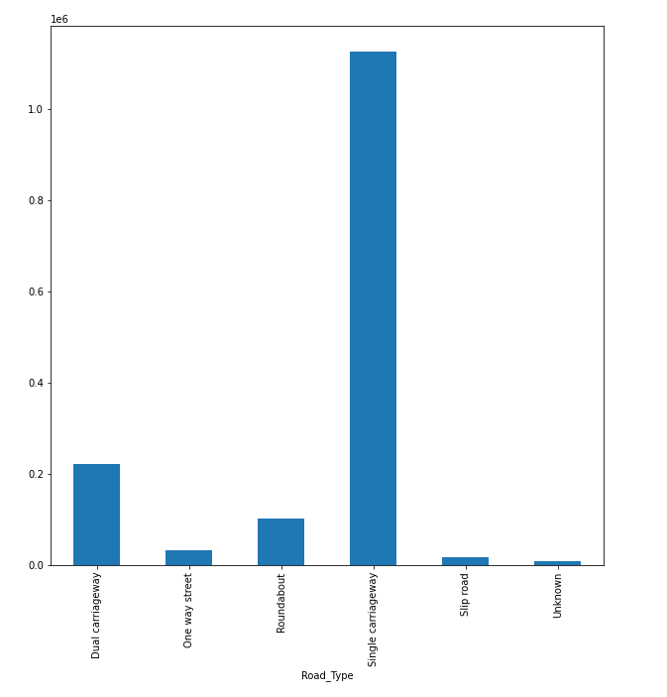
Road Type

Slide 9
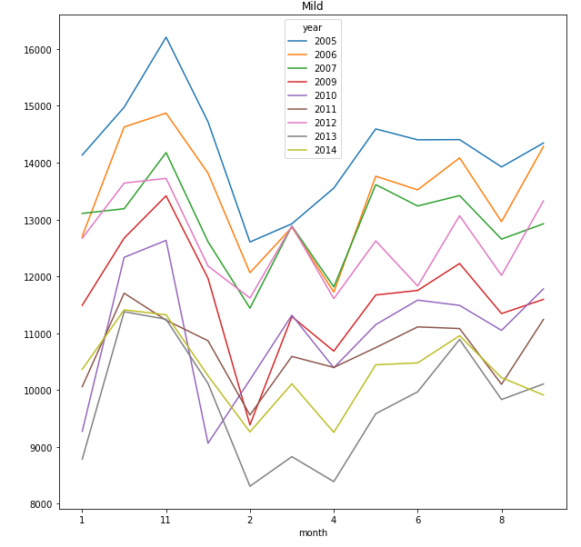
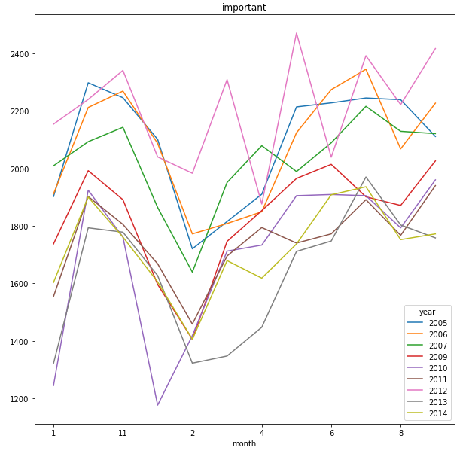
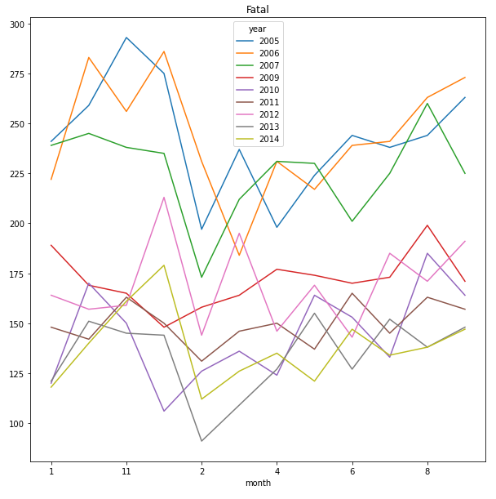
Accident Severity Plotting

Slide 10
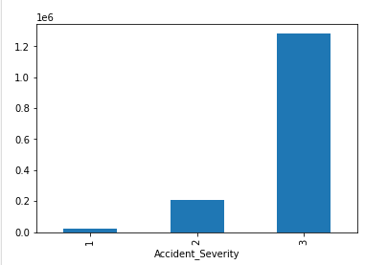
Accident Severity in Bar

Slide 11
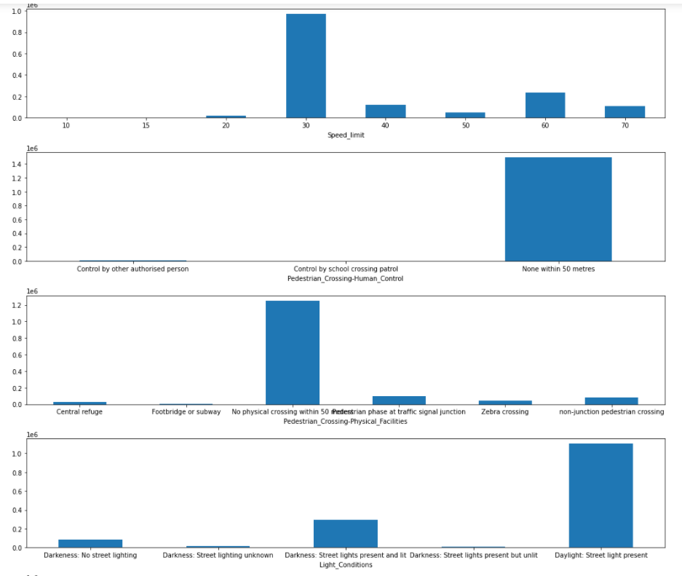
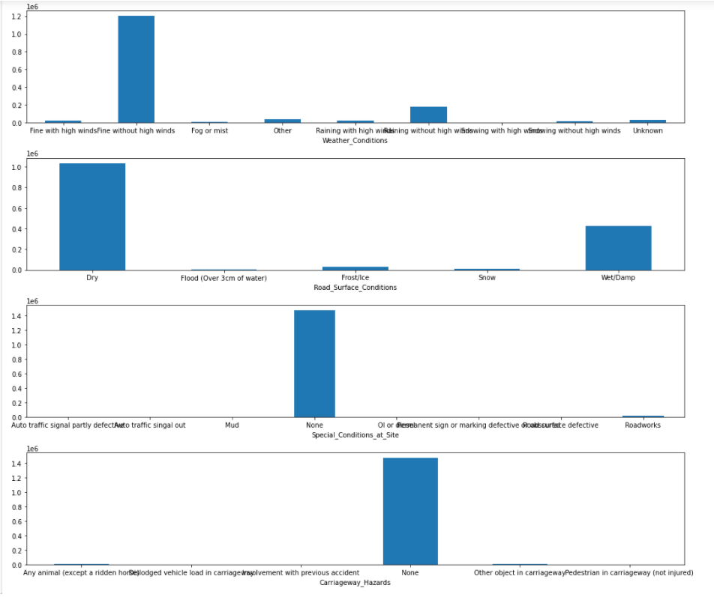
Accident Causes

Slide 12
DJANGO

Slide 13
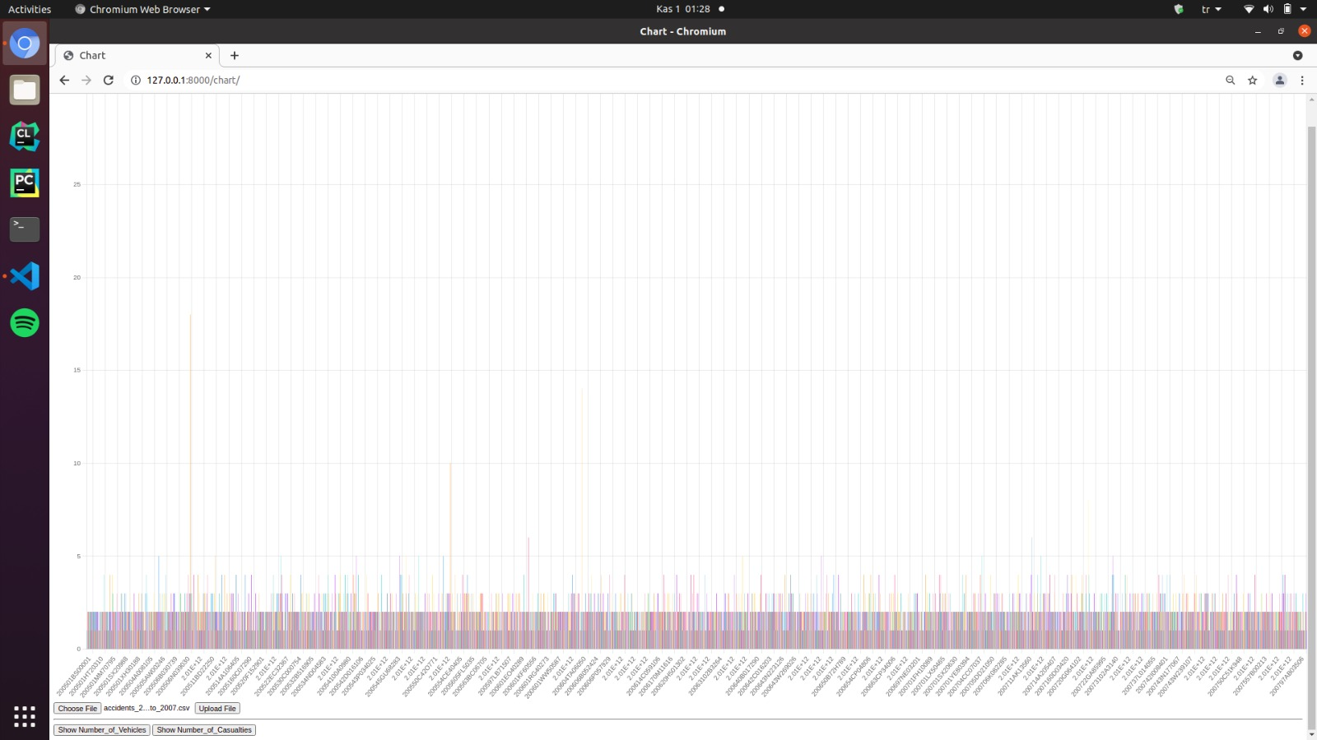
BUTTONS

Slide 14
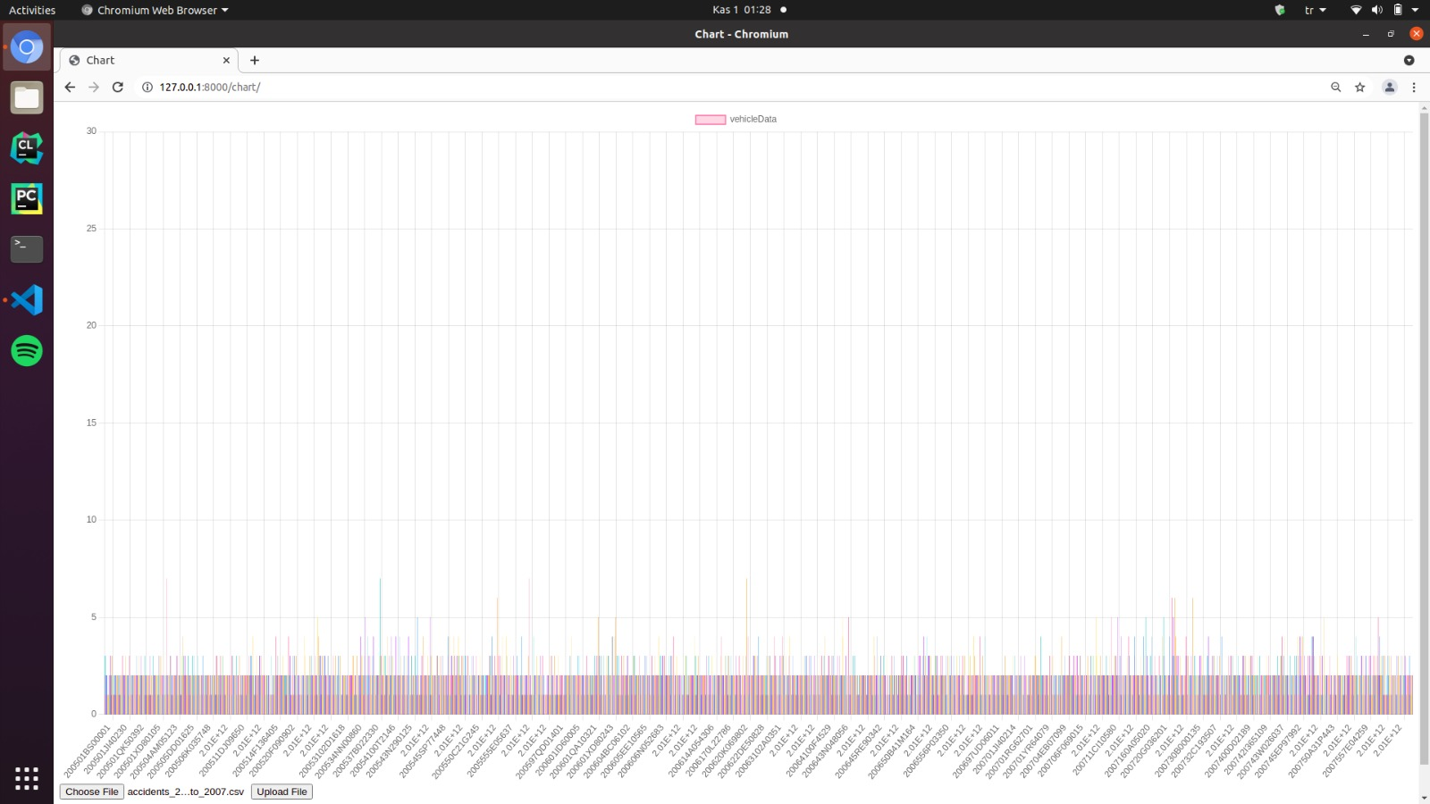
VEHİCLE DATAS OF 2005-2007

Slide 15
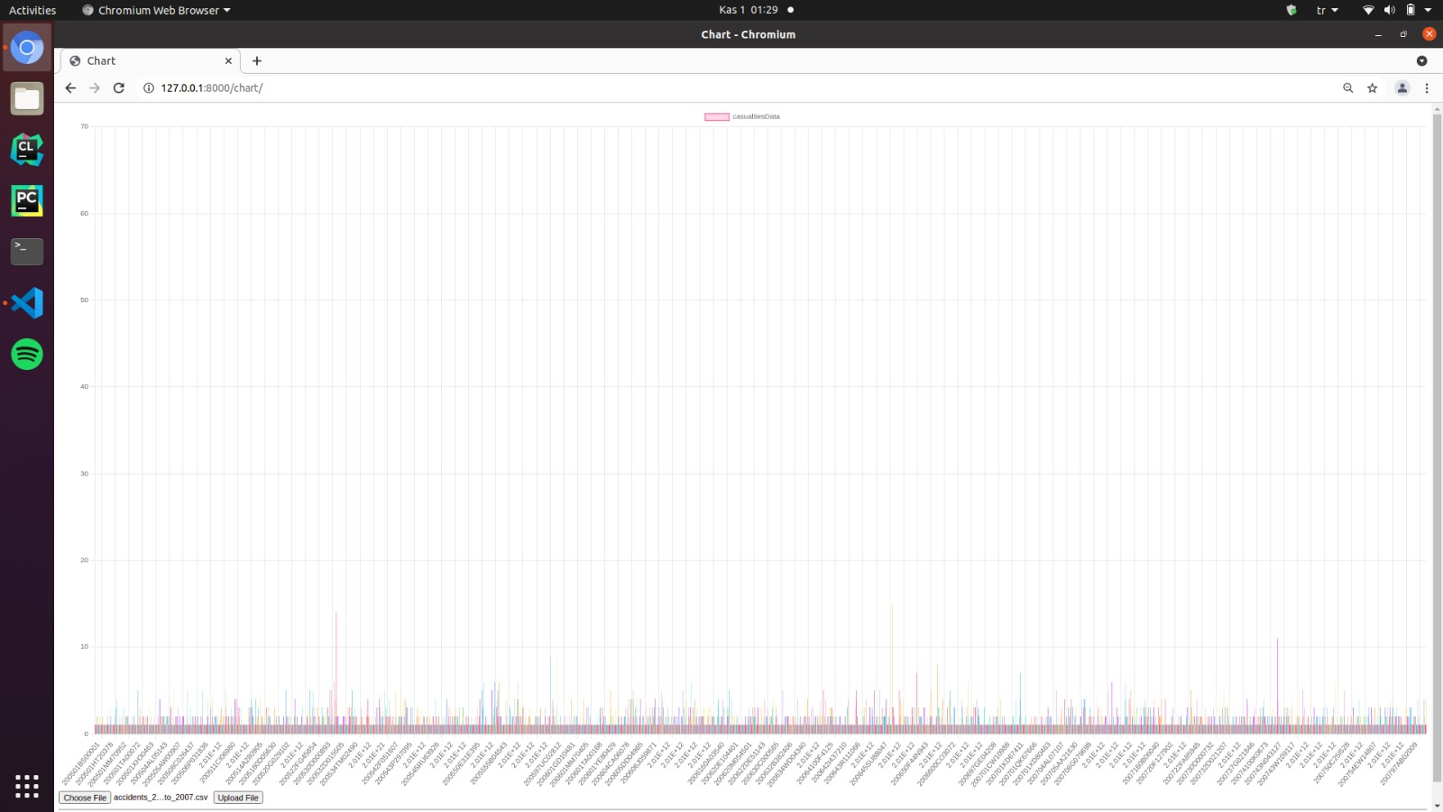
CASULATİES DATA OF 2005-2007

Slide 16
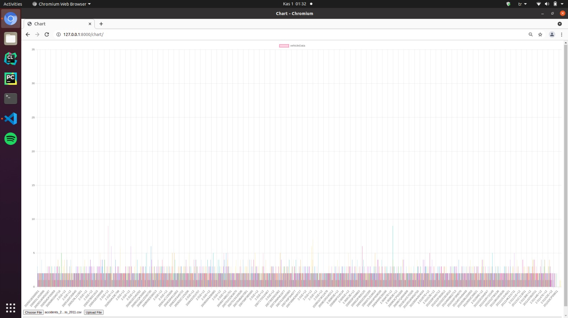
VEHICLE DATAS OF 2009-2011

Slide 17
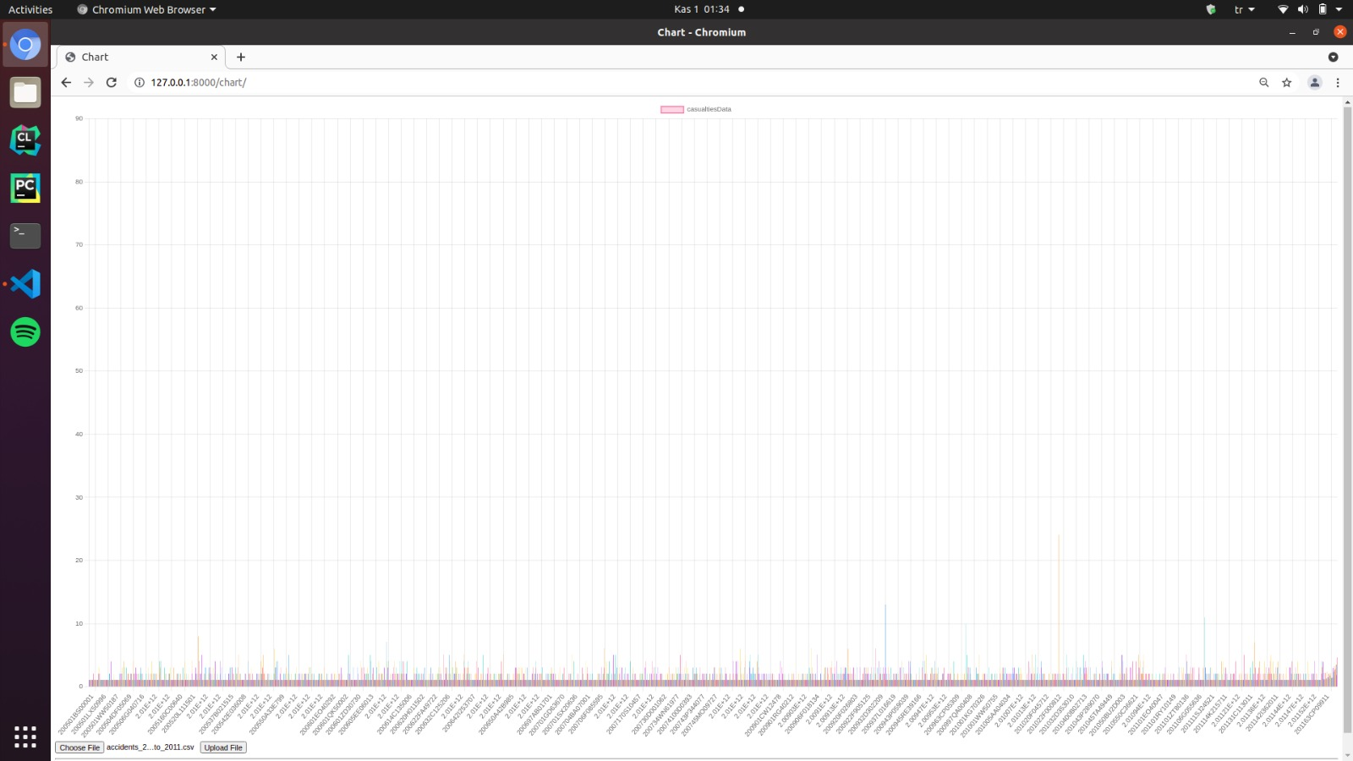
CASULATIES DATAS OF 2009-2011

Slide 18
THANK YOU :)

